Slide 1
Jane’s Training – MORS
Jack Borthwick
Account Manager
Mobile: +447929 016428
Jack.Borthwick@ihsmarkit.com
Sebastian Kidson
Trainer
Mobile: +447970 939904
Sebastian.kidson@ihsmarkit.com

Slide 2
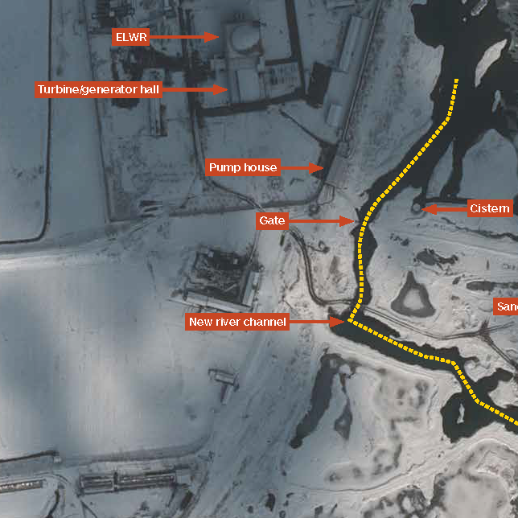
From traditional publisher to global open source intelligence agency
International
Defence Review
1946
Sentinel Country
Risk Assessment
1994
Fighting Ships
1898
Defence Weekly
1984
Jane’s Data Analytics
2015
1909
All the World’s Aircraft
1979
Armour and Artillery
2002
Jane’s Terrorism
& Insurgency Centre
2020
Jane’s
Data Model
1989
Intelligence Review

Slide 3

Overloaded by the sheer volume of information available, how can you determine which information can be trusted and where to focus your resources?
43 zettabytes of data will be created by 2020, a 300X increase from 2005
2.5 Quintillion bytes of data are created every day
Most companies have at least 100 terabytes of data
4 Billion+ hours of video are watched on YouTube every month
400 Million tweets are sent per day by 200 million active users
Notes:
Source - https://uk.emc.com/leadership/digital-universe/2014iview/executive-summary.htm

Slide 4
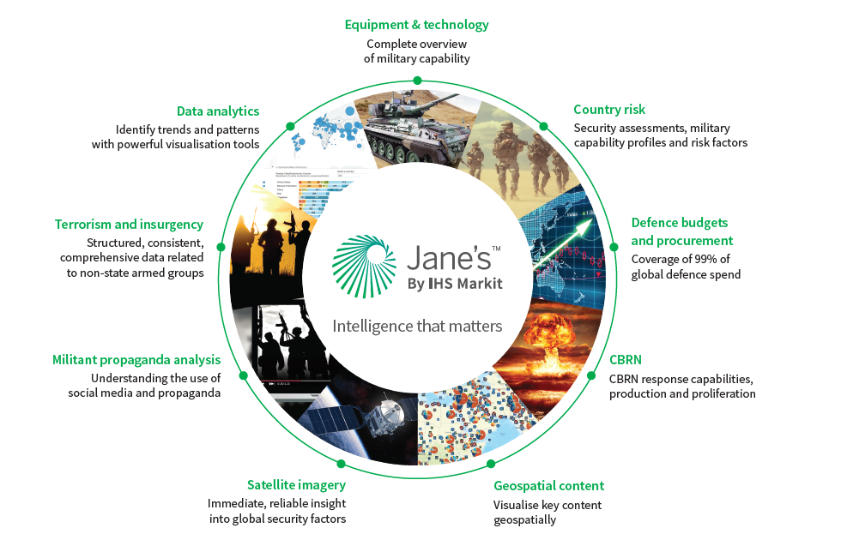

Slide 5

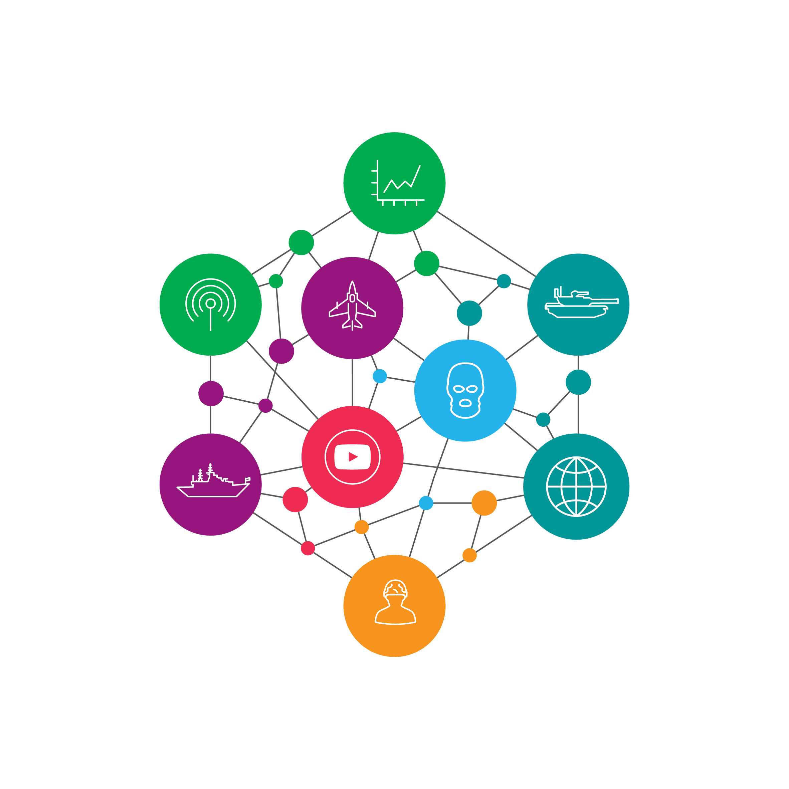
Evolving to meet our customers’ changing requirements
Overloaded by the sheer volume of information available, how do you determine which information can be trusted and where to focus your resources? The Jane’s Data Model will make sense of the noise to deliver a 360° view of a piece of equipment, a country or an organisation.
Open Sources
Overwhelming volumes of inconsistent and unstructured data from multiple sources which is neither structured, verified or validated and may contain misinformation.
Jane’s classification engine
Applies the world’s most consistent and structured defence nomenclature across multiple entities and defines their relationships.
Jane’s OSINT Data Model
Delivers unique unclassified, validated, verified, fact-based common intelligence and operational defence data model that enables you to discover previously hidden connections.

Slide 6


Jane’s Global Defence Expertise
With more than 100 years of experience, Jane’s delivers unparalleled aerospace, defense and security insights.
Our renowned defence expertise, help you optimize operations and mitigate commercial risk to make more impactful decisions.
Jane’s insights are created by 200+ analysts based around the world and a further 2,000+ subject-matter experts in our network.
In-house defence analysts: 200+

Slide 7
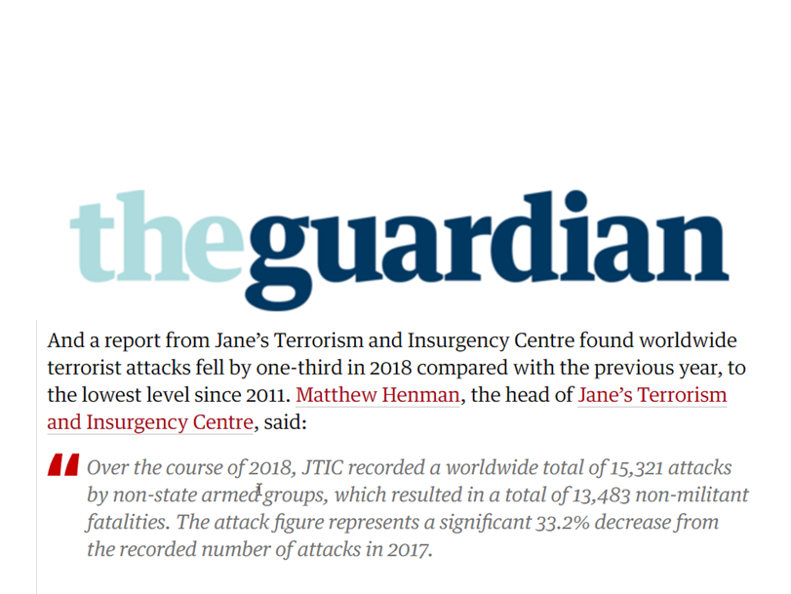
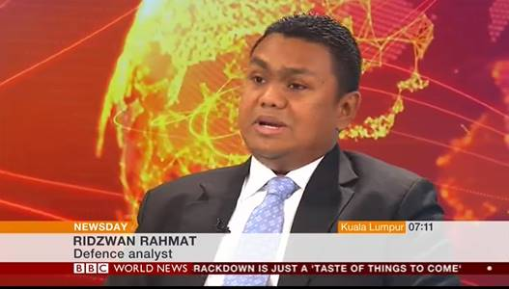

Jane’s global defence expertise
Our renowned defence expertise, helps you optimise operations and mitigate commercial risk to make more impactful decisions.
Jane’s insights are created by 200+ analysts based around the world and a further 650+ subject-matter experts in our network. Experts in their fields, Jane’s analysts apply geopolitical, technological and economic context that provides a holistic picture which includes both impact and what if analysis. They are often called upon by the world’s media to discuss key topics impacting defence and security.

Slide 8
Supporting your missions and objectives
Jane’s increases your awareness of the operational environment by providing open source information and intelligence that supports threat and capability assessment, event analysis, change detection and equipment recognition.
What are Iran’s intentions and capabilities to close the straits of Hormuz?
What are the comparative capabilities of UK and Russian fighter aircraft?
How have events in the Donbass region developed since the beginning of the conflict?
How is China progressing with its efforts to increase its warship construction?
More than 41,500 live equipment profiles
Inventories for 195 militaries
More than 360,000 events related to terrorism and insurgency
More than 550,000 events impacting risk or security

Slide 9
Open source information and intelligence you can trust
All sources assessed for:
  Bias and objectivity
  Reliability
  Level of certainty
  Predictive value
We are transparent about:
  Data quality and limitations
  Analysis logic
  Level of certainty about forecasts
Jane’s provides verified and validated open source information and intelligence enabling us to offer you the highest levels of assurance.

Slide 10
Utilising your Jane’s subscription

Slide 11
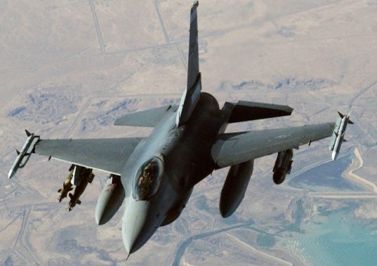
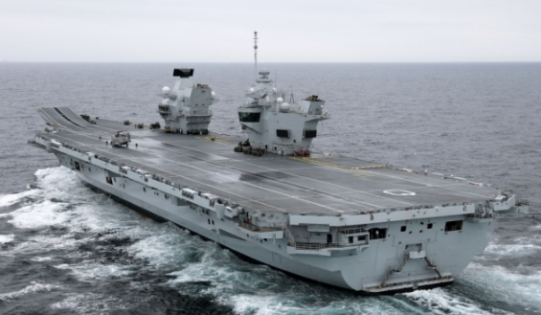
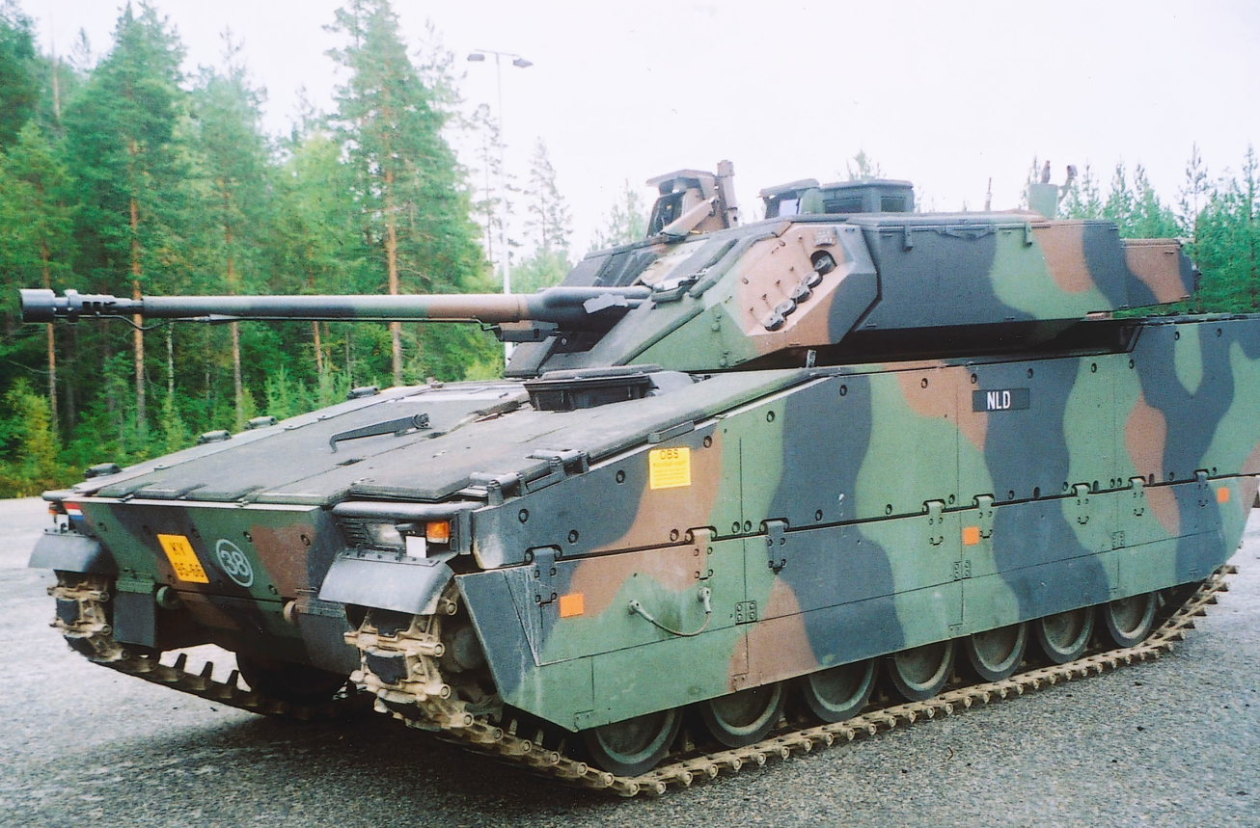
Jane’s Defence Equipment & Technology Intelligence Centre
Jane’s Defence Equipment and Technology Intelligence Centre provides detailed specifications across the world’s land, air and sea platforms, weapons, C4ISR systems and CBRNE & EOD equipment. Together with technical, operational and commercial insight Jane’s equipment information offers the world’s only resource for a complete overview of military capability.
Jane’s Defence Equipment & Technology Intelligence Centre enables you to:
Use technical, operational and commercial news to support key activities
Derive essential insight through independent expert analysis
Stay at the forefront of developments
Research markets
Partner, team and acquire
Strategise and plan
Develop products and technologies

Slide 12
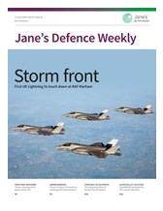
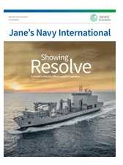
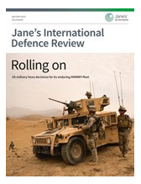
Jane’s Defence: News Module
The Defence News Module offers the full suite of Jane’s world leading defence news offerings, including the award-winning titles of Jane’s Defence Weekly, Navy International, Missiles & Rockets, Defence Industry, and International Defence Review.
Jane’s Defence News Module helps you:
Gauge the impact of changes to military capabilities
Keep current with emerging technologies
Quantify new program and product potential
Identify potential partners, customers and suppliers
Monitor the effects of political disruptions

Slide 13
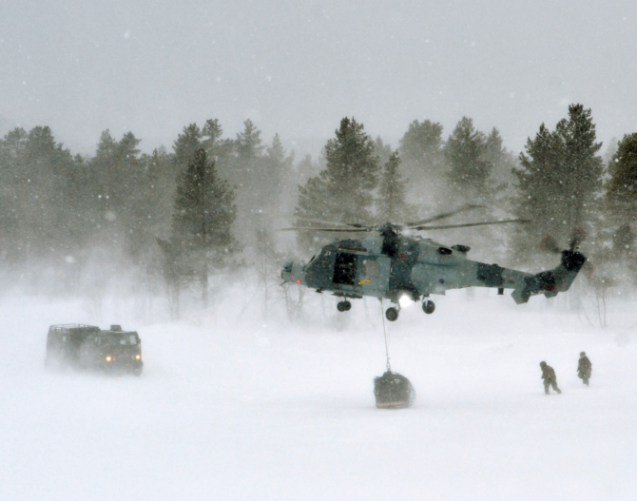
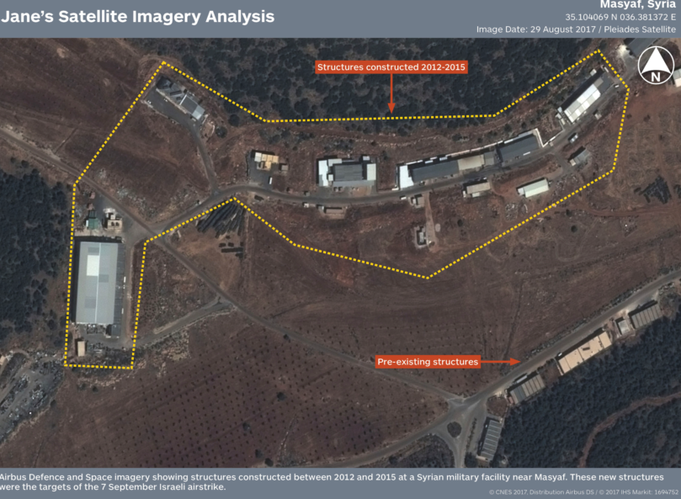
Jane’s Military & Security Assessments Intelligence Centre
Jane’s Military and Security Assessments Intelligence Centre provides comprehensive open-source data and independent expert analysis on political stability, military capabilities, national security concerns, and international relations to give a strategic, operational and tactical understanding of the global threat landscape.
Jane’s Military & Security Assessments Intelligence Centre provides you with:
Authoritative intelligence on the world’s armies, navies, air and special forces including structure, materiel, order of battle, training, doctrine and strategy
Insight into country risk and threats to state stability
Comprehensive open-source threat landscape assessment
Coverage of over 190 states and territories for a view of the global landscape
Data that has been rigorously reviewed and cross-checked to ensure accuracy, reliability and utility

Slide 14
Jane’s Military & Security Assessments Intelligence Centre
Military Capabilities
Country Risk
Security News Module
Satellite Imagery Analysis
Army
Sentinel Country
Risk Assessments
(17 regions)
Intelligence Review
Events Analysis
Navy
Country Risk Daily Report
Facility Analysis
Air Force
Intelligence Weekly
Special Forces
Terrorism & Insurgency Monitor*
Activity Analysis
Terrorism Watch Report*

Slide 15
Jane’s Security: News Module
Jane’s Security News Module provides international security news, analysis, insight and context. Reporting and analysis addresses political, social and economic threats, terrorism and insurgency and organised crime at a national, regional and global level.
From tactical briefs to strategic insight, Jane’s helps you see the bigger picture:
Daily reports – rapidly produced responses to risk-relevant events that have occurred around the world. They an overview of the events, analysis and an outlook which sets out the risk implications and what the change means for your risk environment.
Intelligence briefs – analysis on key strategic trends and changing risks which enable you to understand what the details mean for the bigger picture.
Special reports – Jane’s analysts use advanced analytical techniques including scenarios, influence maps, IMINT, SOCMINT and GEOINT in conjunction with their own expertise to provide in-depth and original insight and analysis.
Major incident response assessments – providing analysis and implications of major incidents as they occur

Slide 16

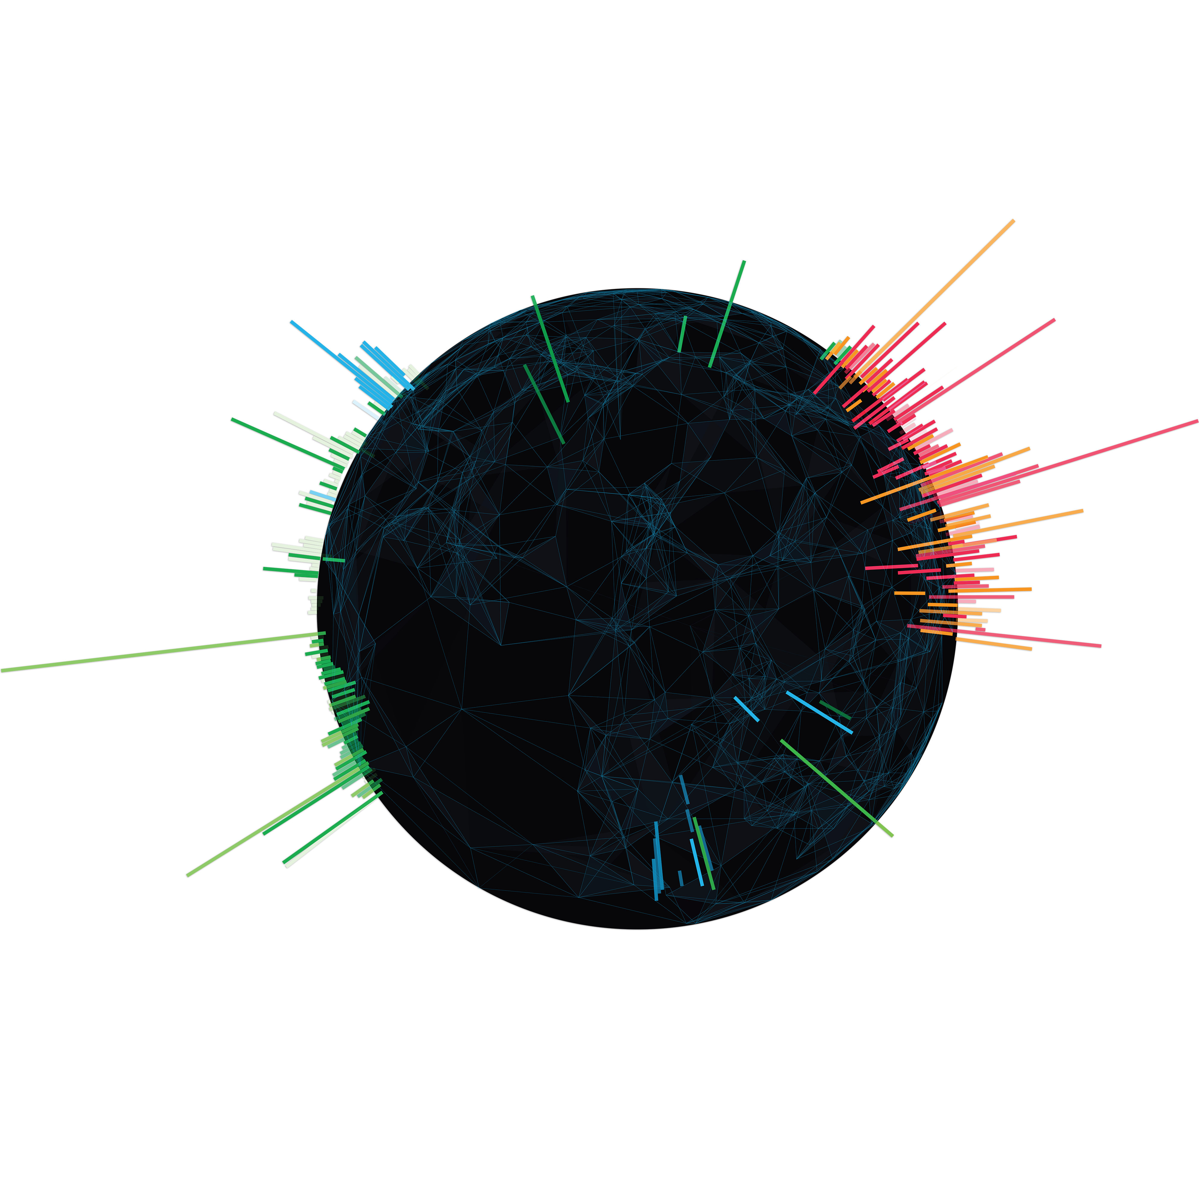
Jane’s Terrorism & Insurgency Centre
Jane’s Terrorism & Insurgency Centre enables you to maintain a global perspective on terrorist activity and to confidently assess the risks affecting government, military and commercial, economic or strategic interests.
Jane’s Terrorism & Insurgency Centre enables you to:
Monitor the activity of non-state actors with daily news and analysis of events
Uncover patterns and shifting trends using data visualisation tools
Incorporate data quickly and easily into proprietary and third-party systems
Identify emerging threats
Understand the context and driving forces behind global unrest, insurgency and terrorist activity

Slide 17
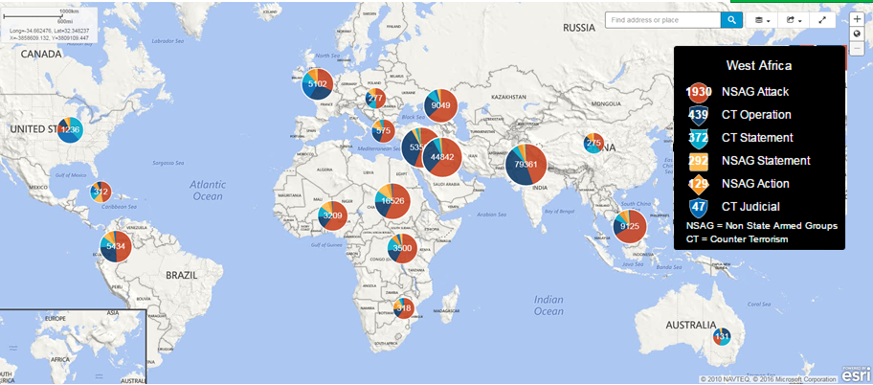
Jane’s Terrorism & Insurgency Centre Spatial Layer
Need to monitor global terrorism activities? Analyse data geospatially?
This intelligence resource delivers global non-state armed group events data from Jane’s Terrorism & Insurgency Centre as a geospatial layer that can be ingested into GIS systems for analysis and integration with related data layers.
This structured data helps you:
More than 250,000 validated and verified terrorist and insurgent events dating back to 2009
Events are geocoded to the most detailed location possible, helping you to identify trends and patterns from a geographic perspective
Identify where specific groups are active
Manipulate verified and validated metadata on events, groups, casualties, attacks and counter terrorism activities

Slide 18
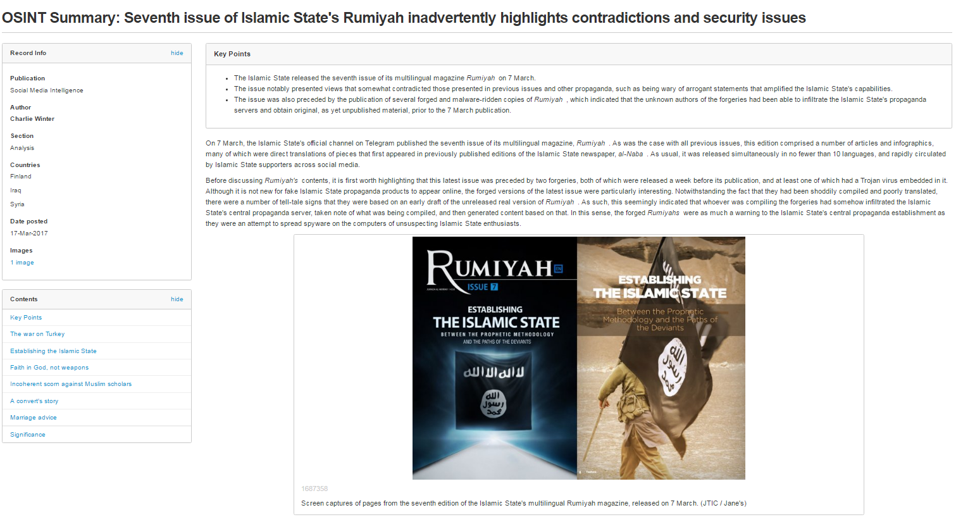
Jane’s Militant Propaganda Analysis
Trusted insights from native language terrorism experts
Understanding the use of social media and propaganda, as well as its distribution and consumption patterns, can offer ahead-of-the-curve insights on politically or ideologically motivated violence conducted by militant actors.
Jane’s helps you to understand the significance of militant propaganda by providing:
A dedicated stream of analysis on the use of a broad range of social media platforms by militant groups
A unique network of native-language terrorism experts who assess militant-produced content in multiple languages
Coverage of an expansive range of group types and ideologies
In-depth daily, weekly, monthly, and ad hoc analysis on social media trends, sentiment, and implications from a global perspective

